Slide 1

Handwritten Digit Recognition

Slide 2
Introduction:
Recognition is identifying or distinguishing a thing or an individual from the past experiences or learning.
Similarly, Digit Recognition is nothing but recognizing or identifying the digits in any document. Digit recognition framework is simply the working of a machine to prepare itself or interpret the digits.
Handwritten Digit Recognition is the capacity of a computer to interpret the manually written digits from various sources like messages, bank cheques, papers, pictures, and so forth and in various situations for web based handwriting recognition on PC tablets, identifying number plates of vehicles, handling bank cheques, digits entered in any forms etc.
Machine Learning provides various methods through which human efforts can be reduced in recognizing the manually written digits.

Slide 3
MAIN GOAL & APPLICATIONS
Handwritten Digit Recognition is used to recognize the Digits which are written by hand.
A handwritten digit recognition system is used to visualize artificial neural networks.
It is already widely used in the automatic processing of bank cheques, postal addresses, in mobile phones etc

Slide 4
Tools and Technologies Used
Tensorflow
Python 3.9
Anaconda3 5.3.1

Slide 5
Existing System
Proposed System
LITERATURE SURVEY
Limitations in Existing System
Advantages over existing system

Slide 6
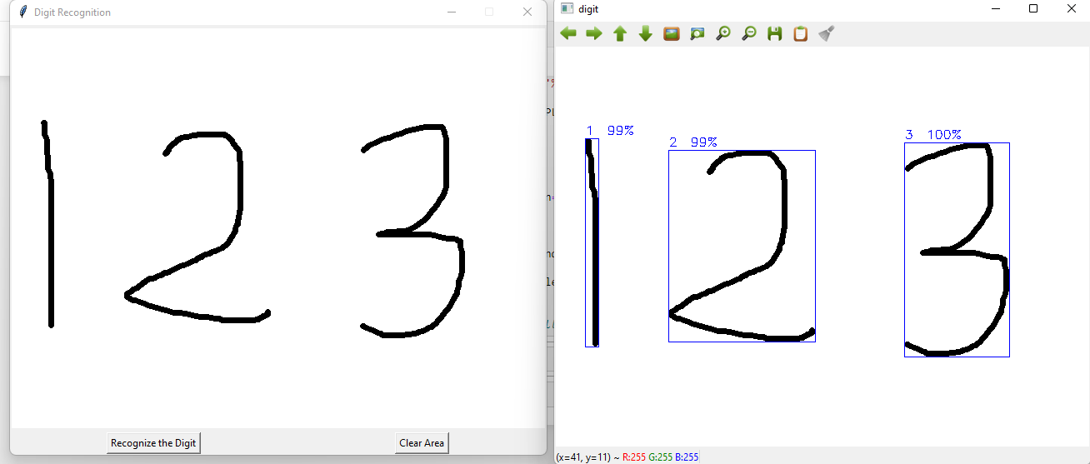
Output

Slide 7
STRENGHTS
S
number plate recognition,
postal mail sorting
bank check processing
WEAKNESS
Low fundraising activities
W
OPPORNTUNITIES
O
ability to recognize the human handwritten digits ike images, papers, touch screens, etc
THREATS
T
Decrease of support by donors
Reduction frequency of newsletters

Slide 8
Future Improvements
Enable Editing
To use of better paid platforms
Better Accurancy
Designing

Slide 9










Slide 10
Conclusion
The Handwritten digit recognition using convolution neural network has proved to be of a fairly good eficiency
IT better works than any other algorithm including artificial neural network

Slide 11
Thank you

